Slide 1
CMPSC 431
Bookstore
John Hofbauer

Slide 2
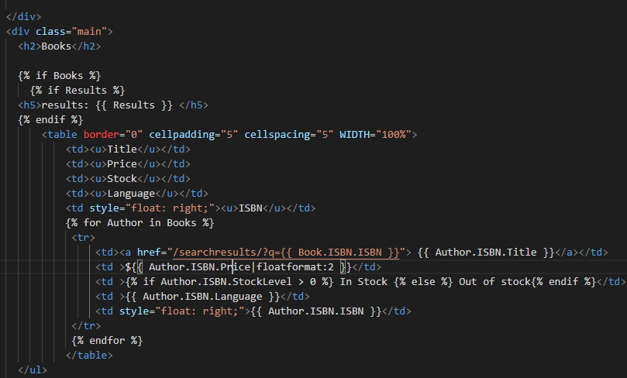
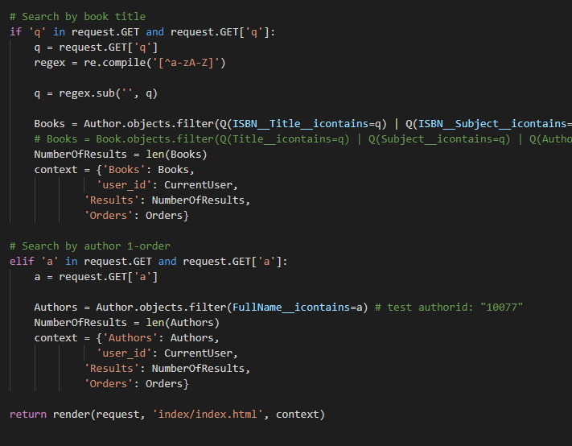
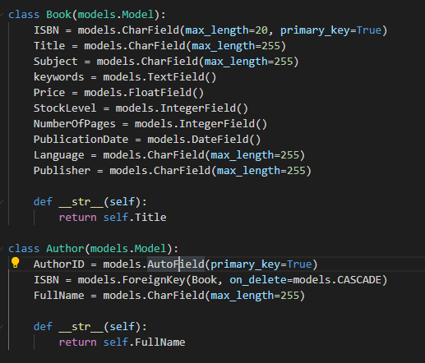
Built

Slide 3
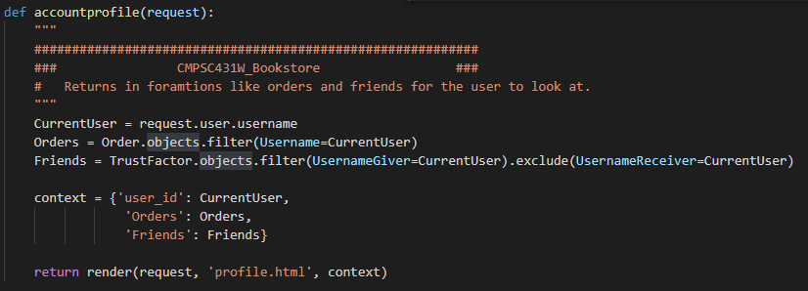
Views.py

Slide 4
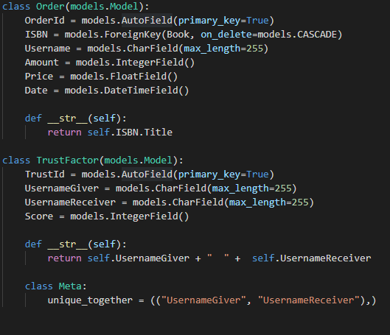
Models.py

Slide 5
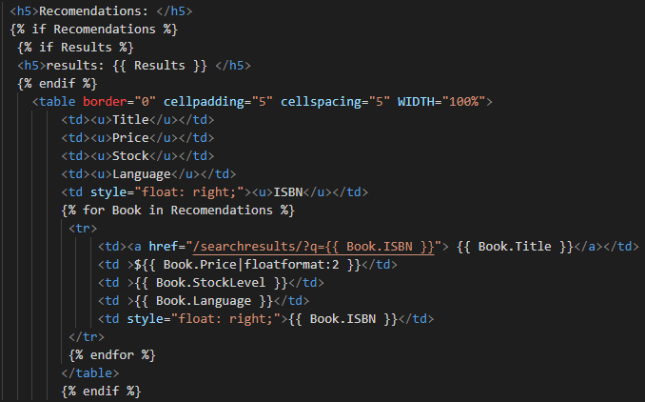
HTML

Slide 6
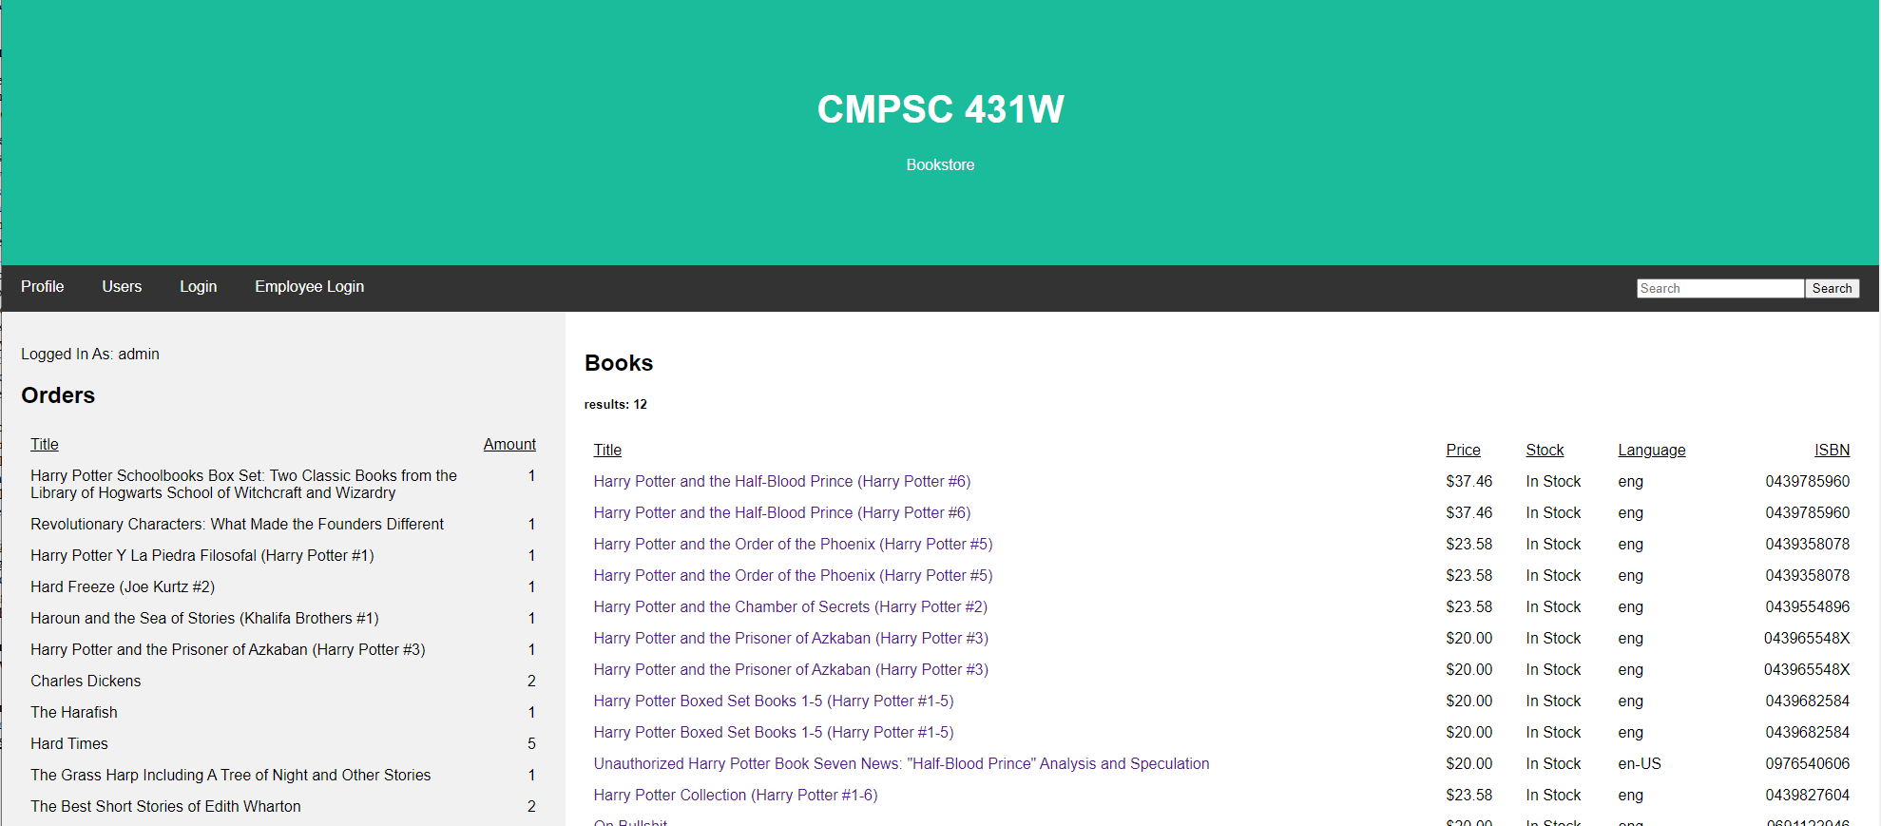
How
Search Results

Slide 7
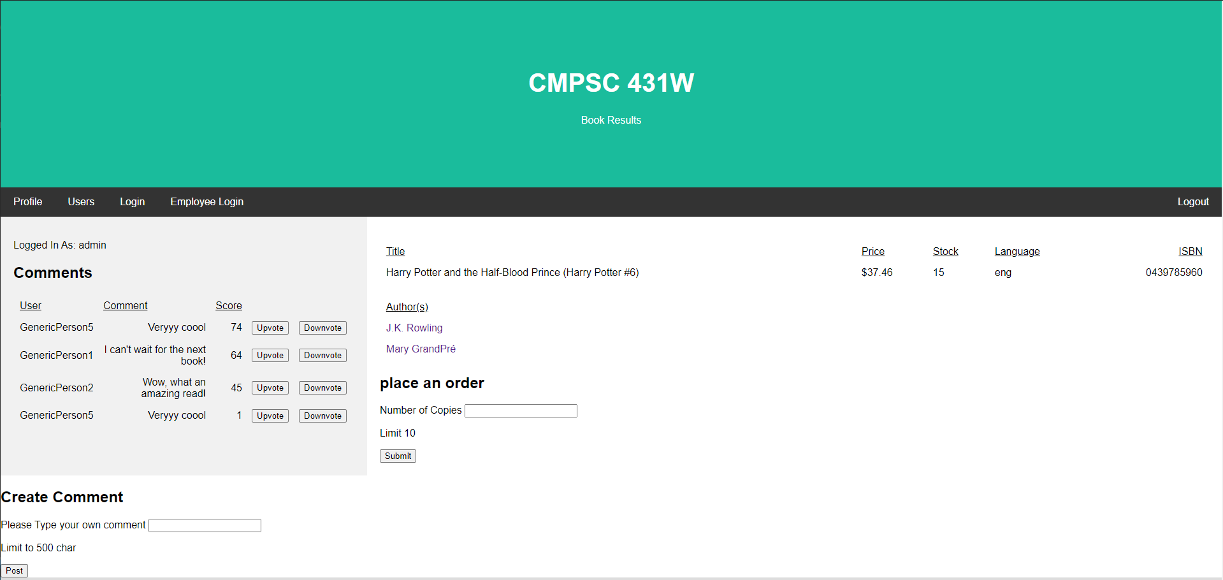
How
Book result

Slide 8
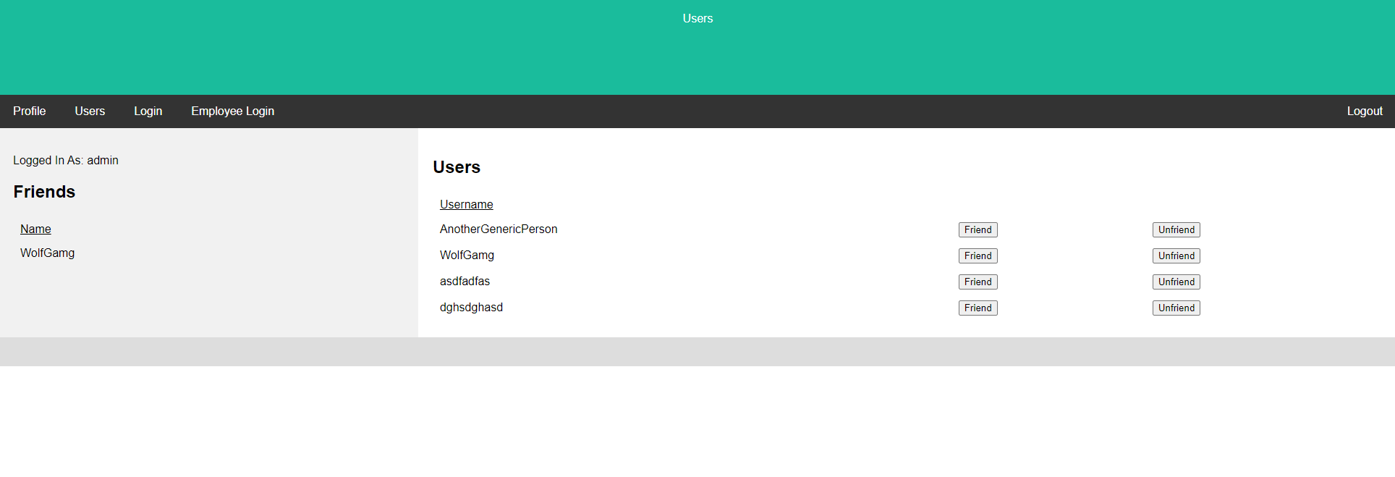
How
Other Users (trust)

Slide 9
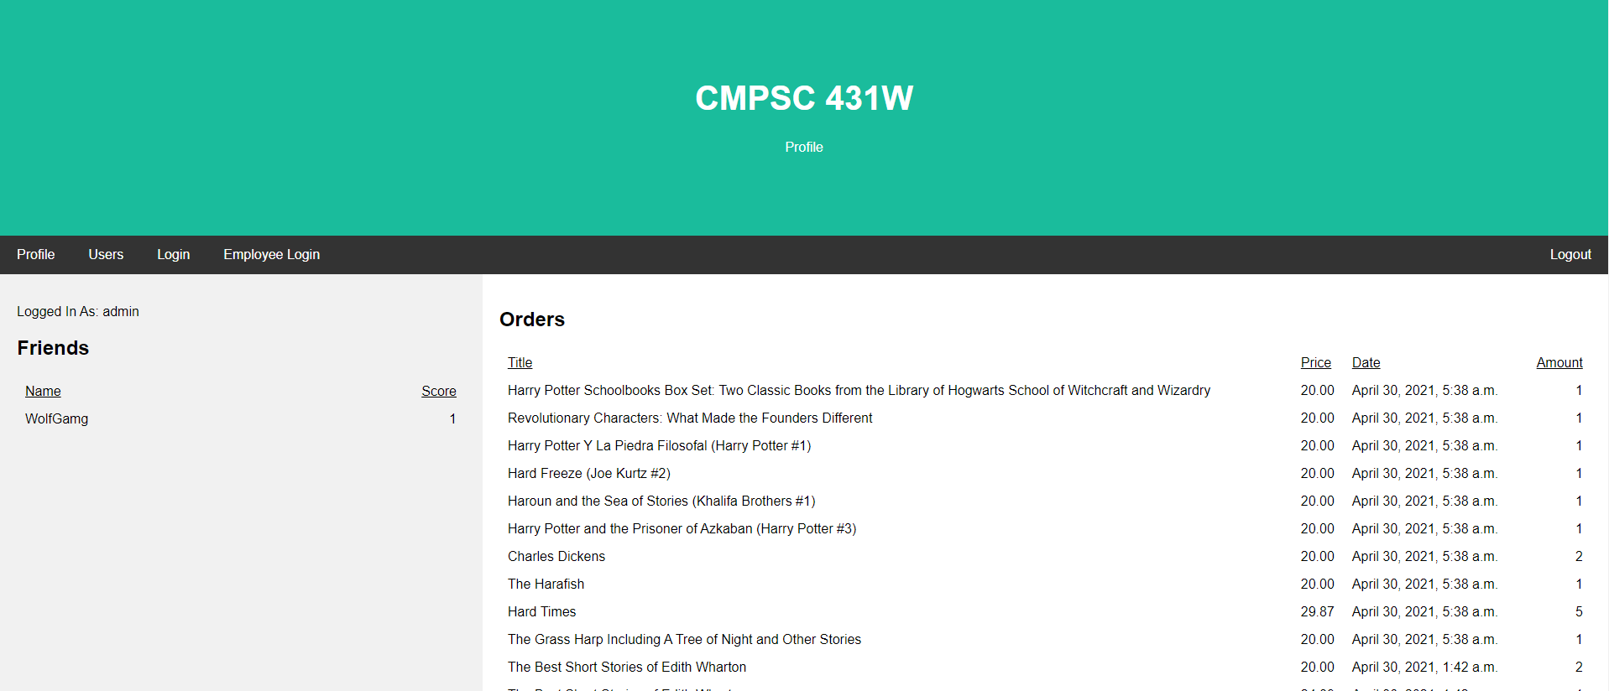
How
User Profile

Slide 10
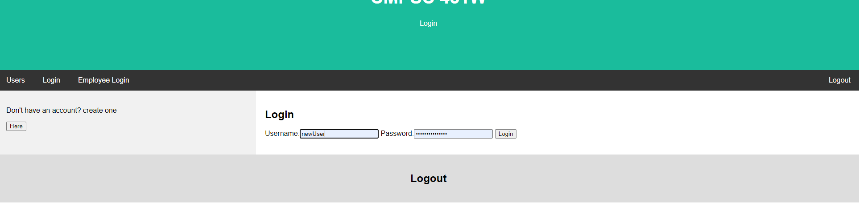
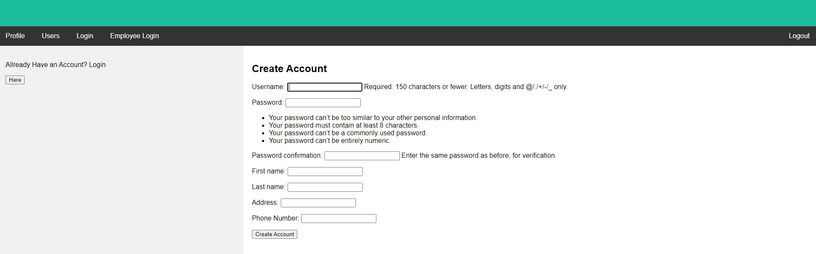
How
Login / Logout

Slide 11
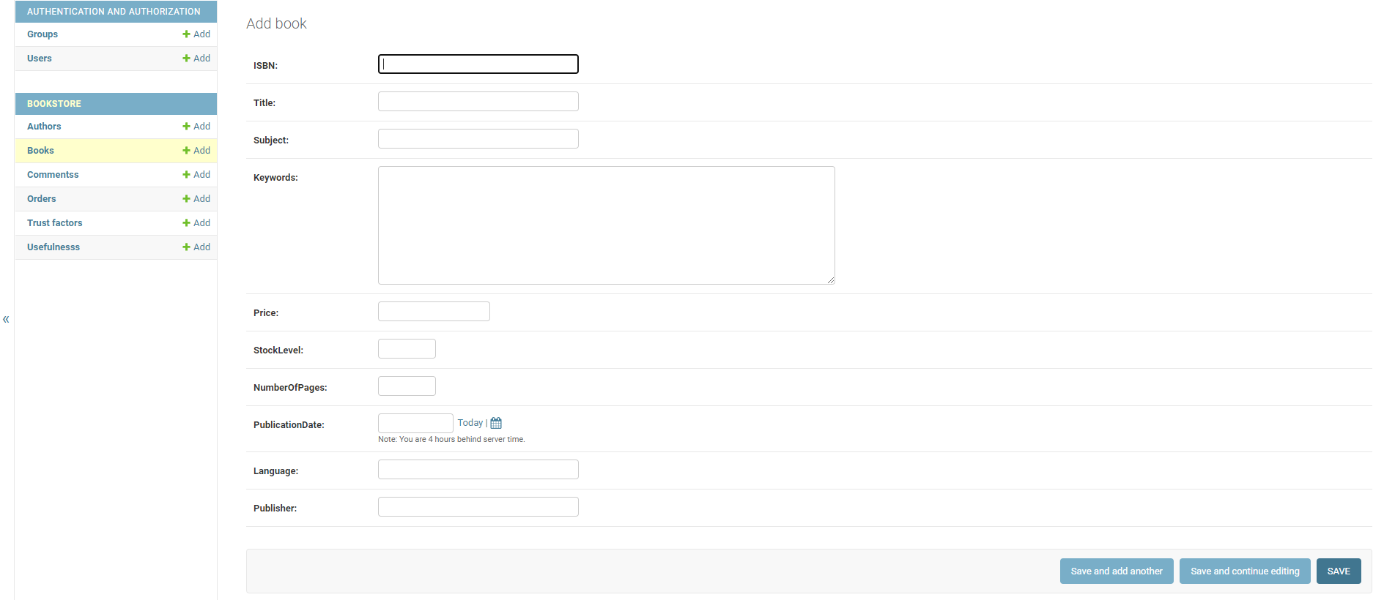
How
Employee ADD BOOKS

Slide 12
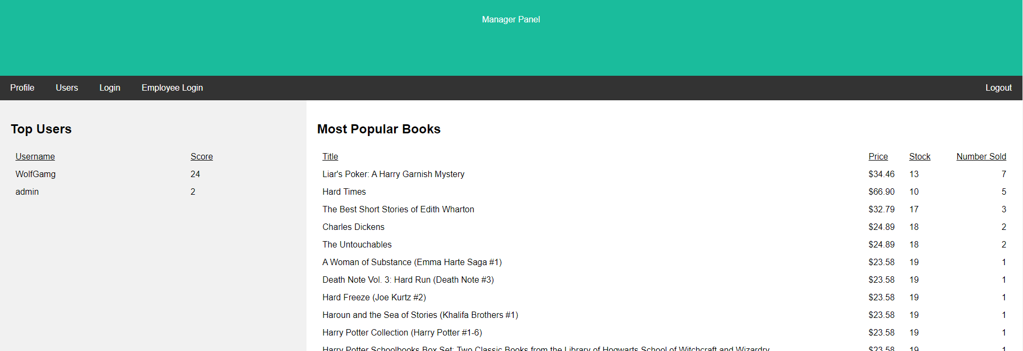
How
Manager View

Slide 13
Challanges

Slide 14
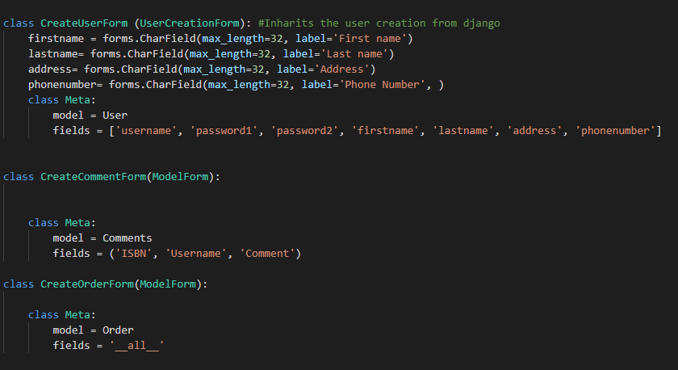
Reflections

Slide 15
Reflections (prevent SQL injection)
Do
NOT!

Slide 16
Citation
W3schools.com

